Slide 1

Project:
Renovation Works at Ricci Hall at 93 Pok Fu Lam Road
VIEW 3
VIEW 1
VIEW 4
VIEW 5
VIEW 2
C
Sub-basement Level
VIEW 6
PROGRESS PHOTO REPORT - 03
Date : 2014-8-21

Slide 2
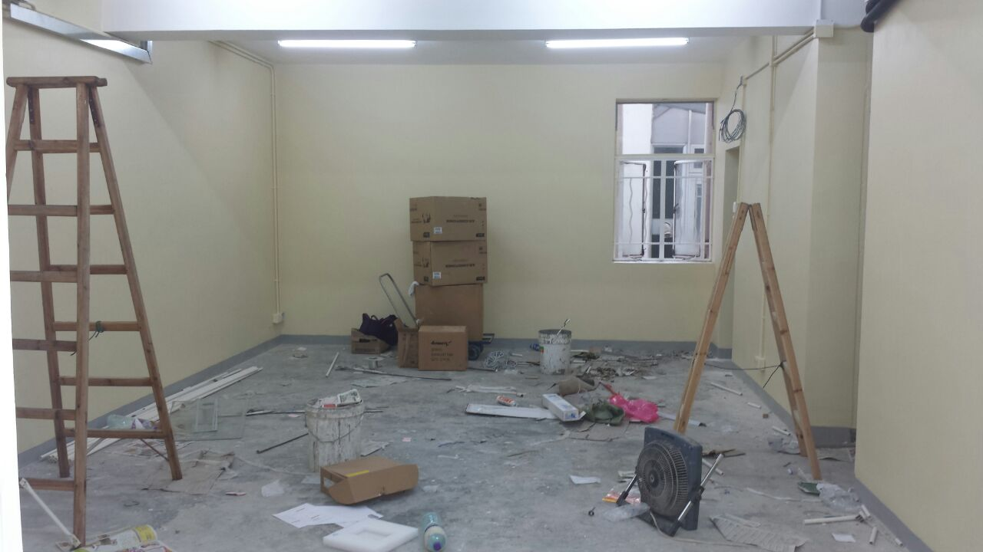
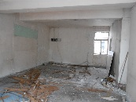
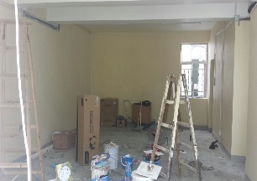
Descriptions
Paint to wall was completed
VIEW 1
2014-7-6
2014-8-14

Slide 3
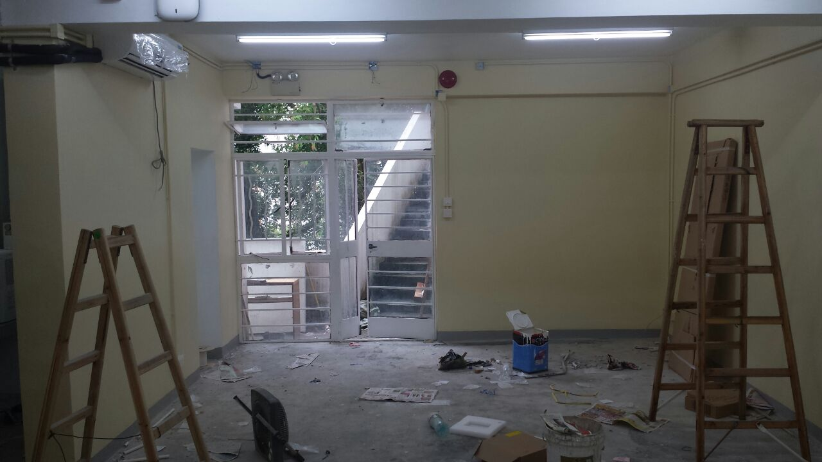
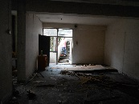
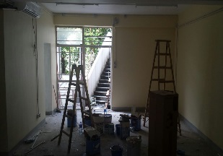
Descriptions
Paint to wall was completed
A/C equipment has installed on site
VIEW 2
2014-7-6
2014-8-14

Slide 4
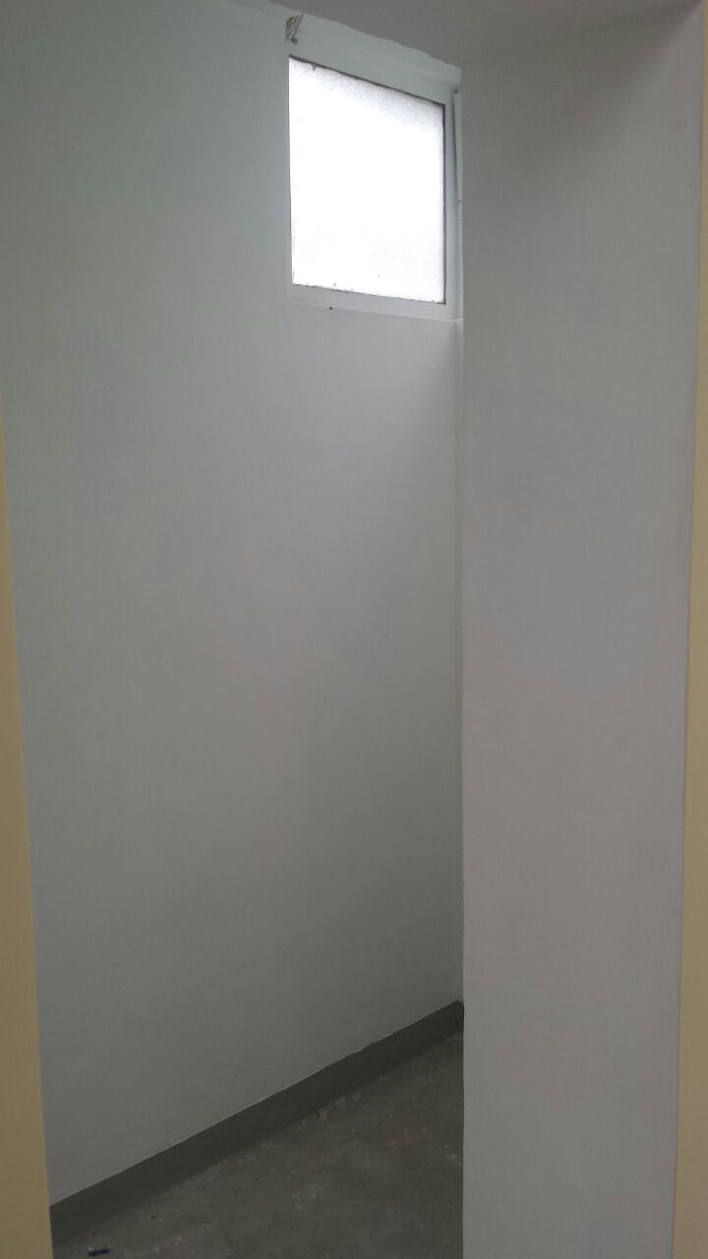
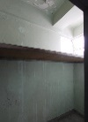
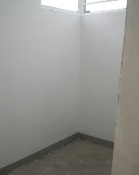
Descriptions
Paint to wall was completed
VIEW 3
2014-7-6
2014-8-14

Slide 5
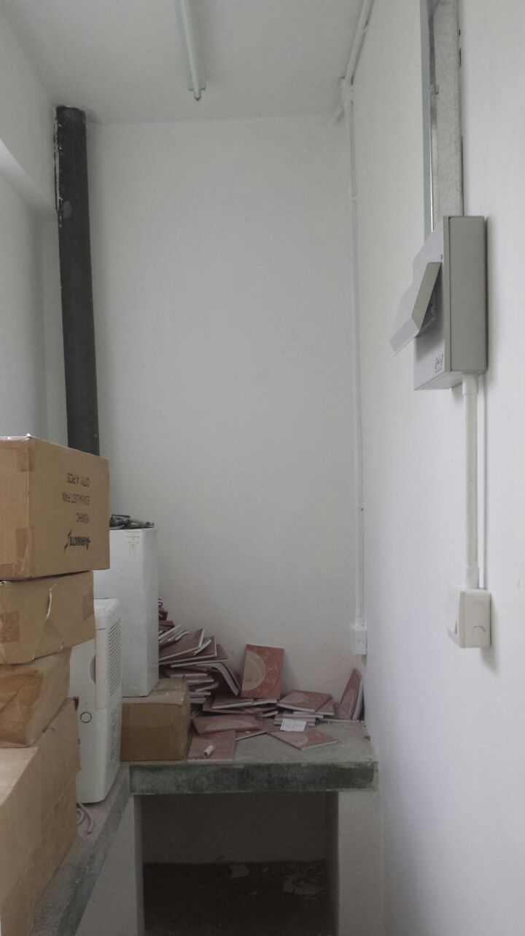
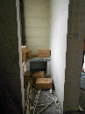
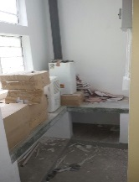
Descriptions
Paint to wall was completed
VIEW 4
2014-7-6
2014-8-14

Slide 6
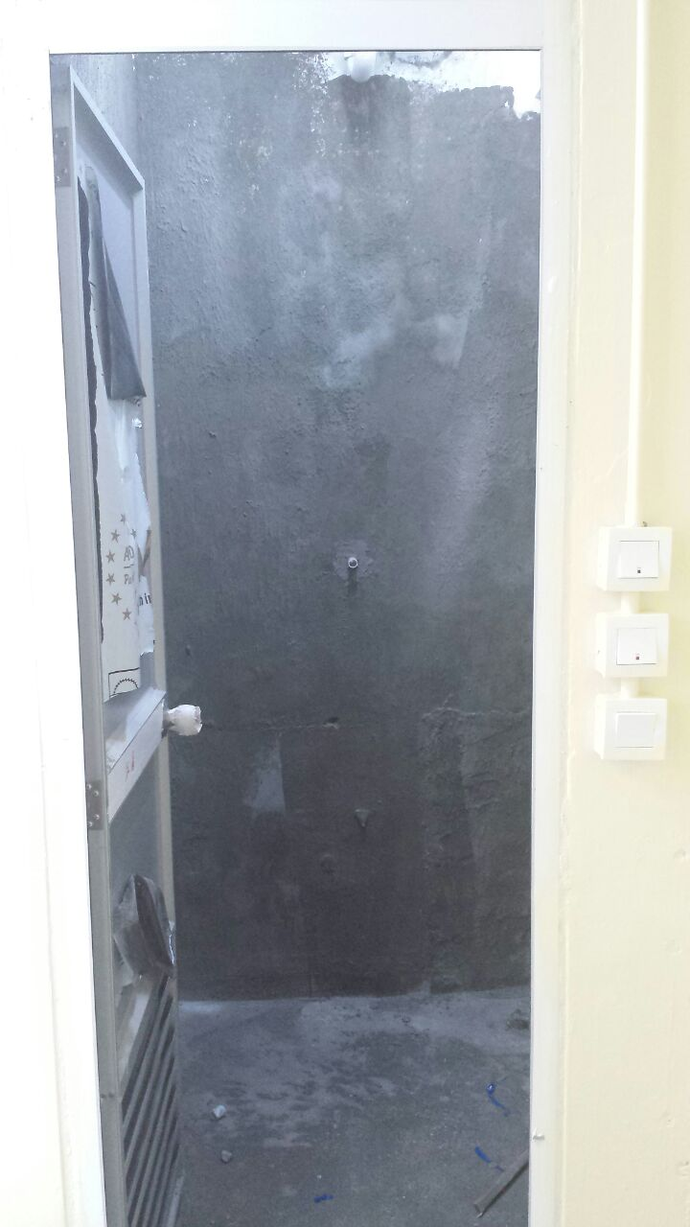
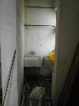
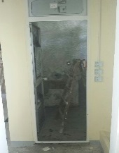
Descriptions
Site condition
VIEW 5
2014-7-6
2014-8-14

Slide 7
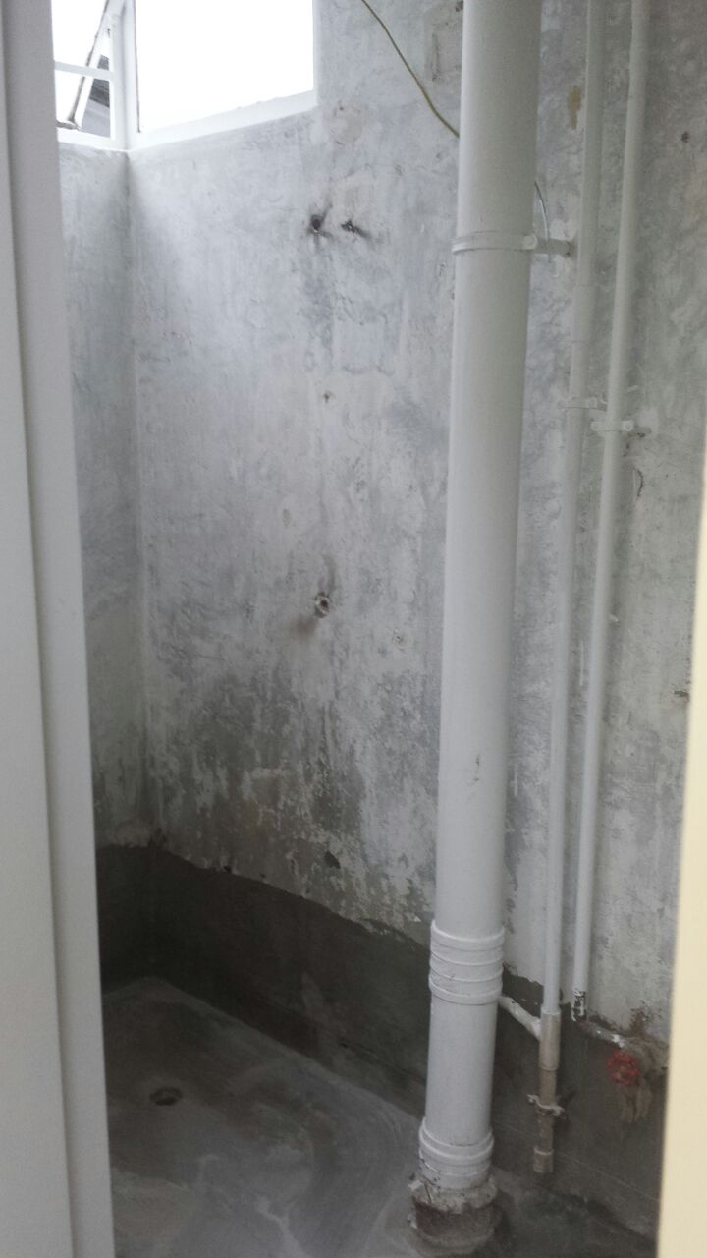
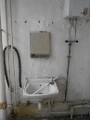
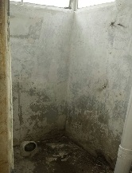
Descriptions
All the existing finish will be demolish
VIEW 6
2014-7-6
2014-8-14

Slide 8
Project:
Renovation Works at Ricci Hall at 93 Pok Fu Lam Road
VIEW 4
VIEW 2
VIEW 5
VIEW 6
VIEW 1
VIEW 7
C
Ground Floor
VIEW 8
VIEW 3
PROGRESS PHOTO REPORT - 03
Date : 2014-8-21

Slide 9
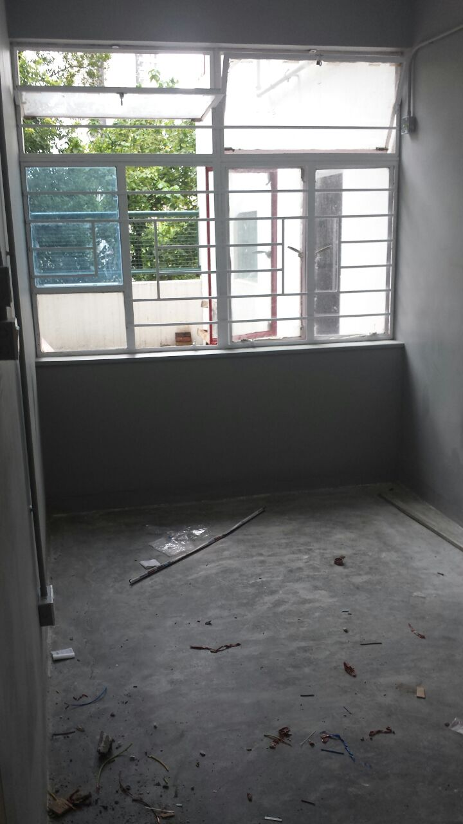
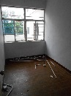
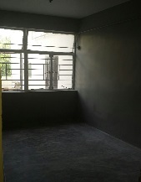
Descriptions
Paint to wall was completed
VIEW 1
2014-7-6
2014-8-14

Slide 10
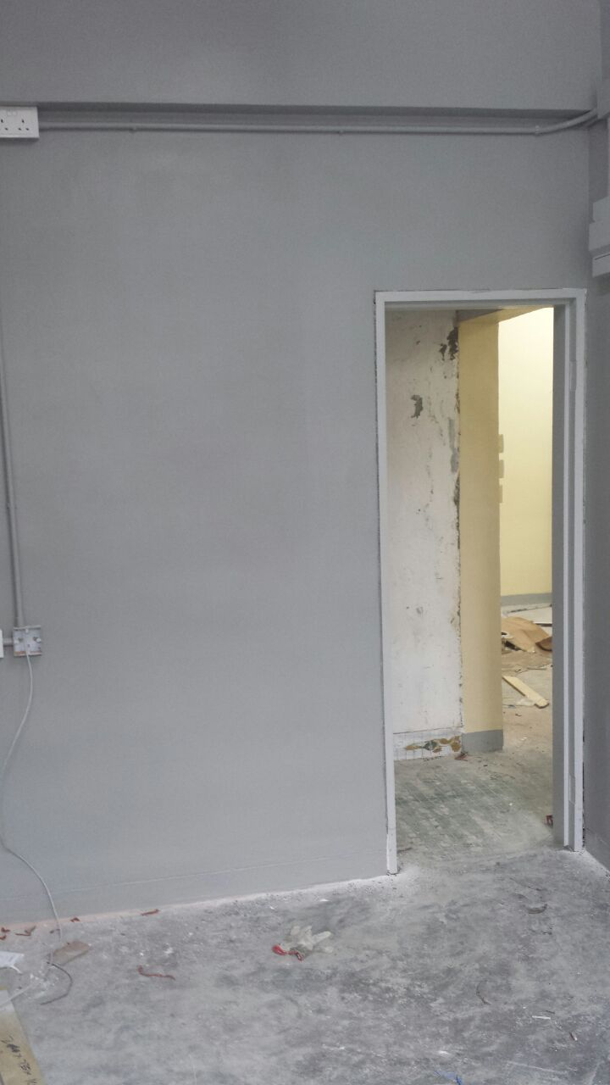
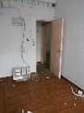
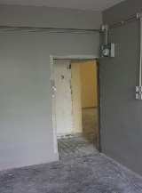
Descriptions
Paint to wall was completed
The door frame has installed
VIEW 2
2014-7-6
2014-8-14

Slide 11
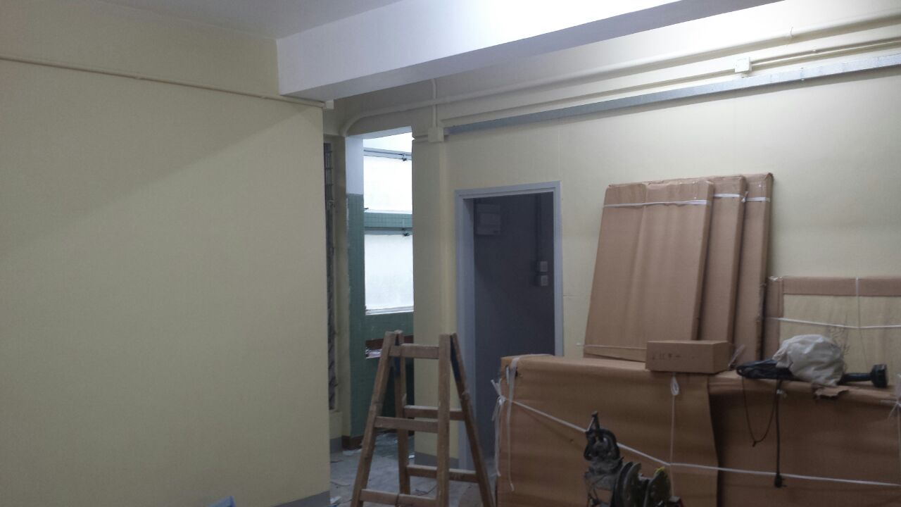
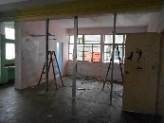
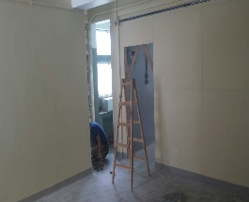
Descriptions
Paint to wall was completed
Furniture arrived on site
VIEW 3
2014-7-6
2014-8-14

Slide 12
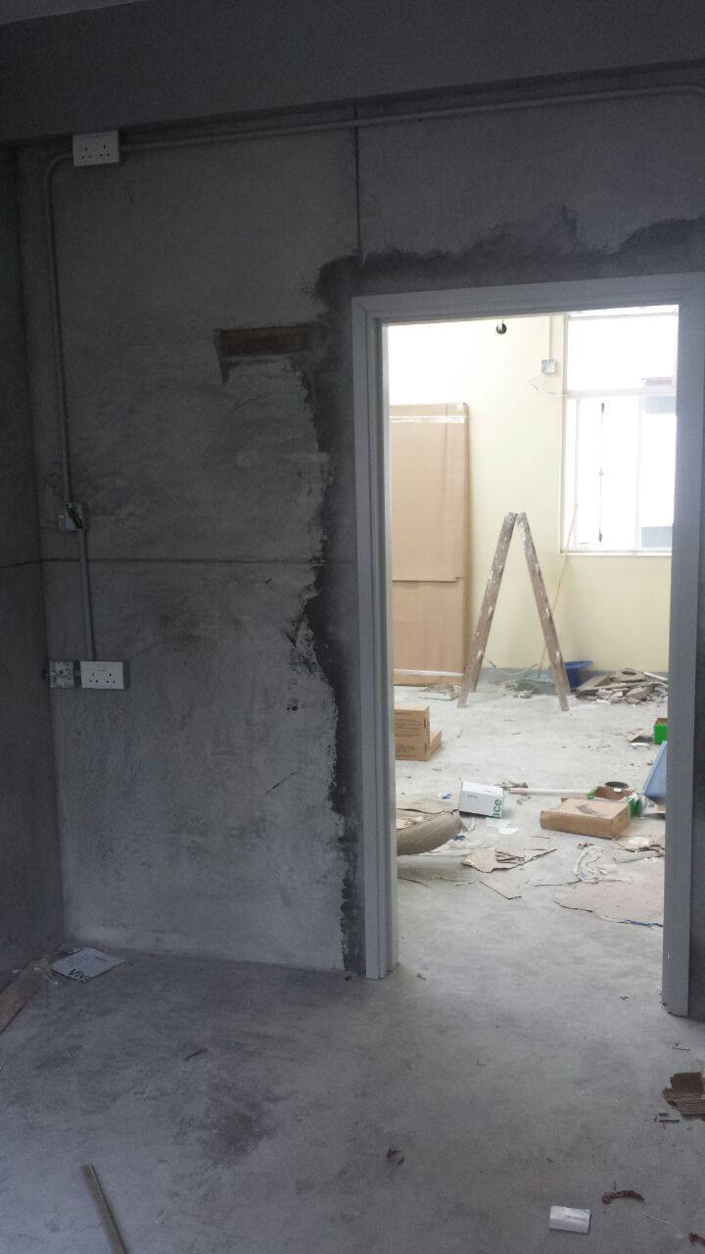
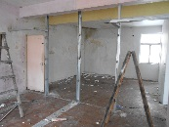
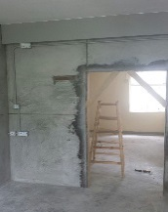
Descriptions
Plastering works in progress
The door frame has installed
VIEW 4
2014-7-6
2014-8-14

Slide 13
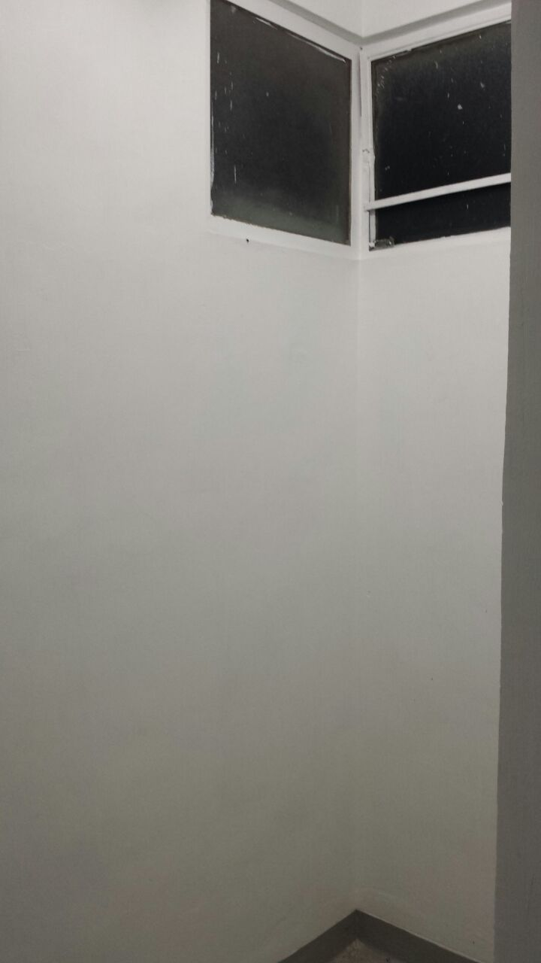
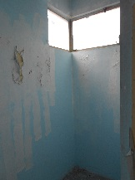
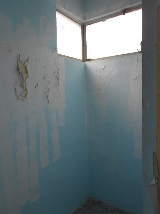
Descriptions
Paint to wall was completed
VIEW 5
2014-7-6
2014-8-14

Slide 14
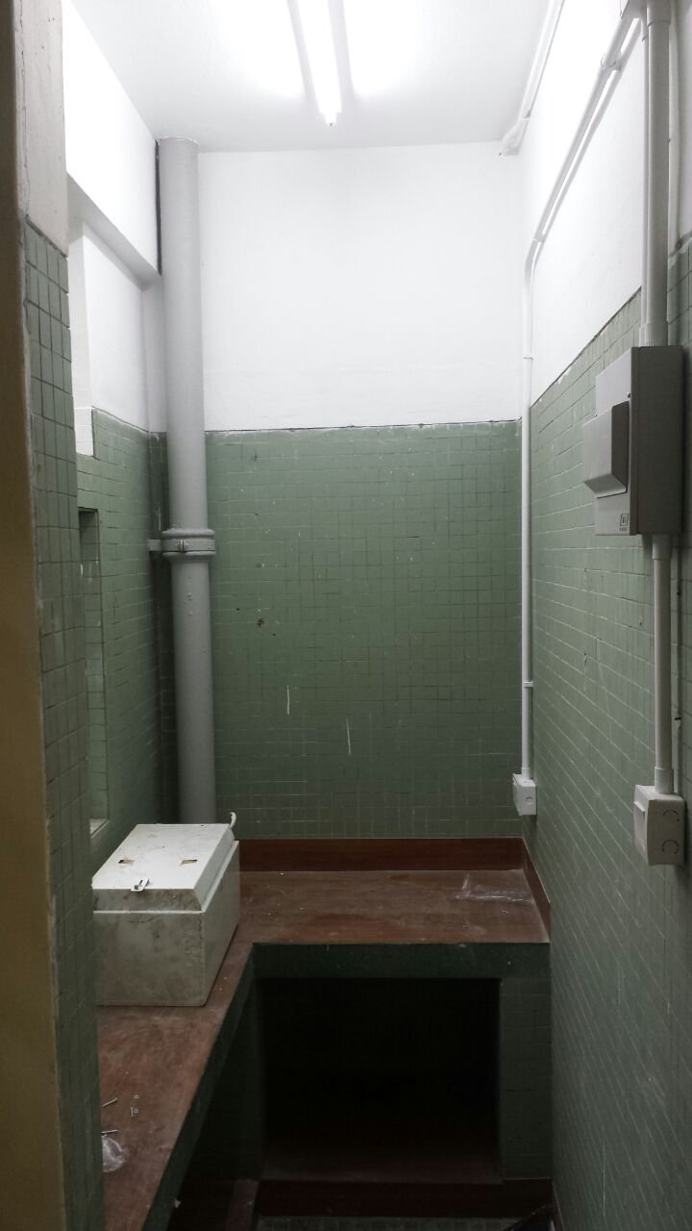
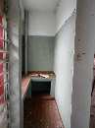
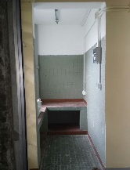
Descriptions
Paint to wall was completed
VIEW 6
2014-7-6
2014-8-14

Slide 15
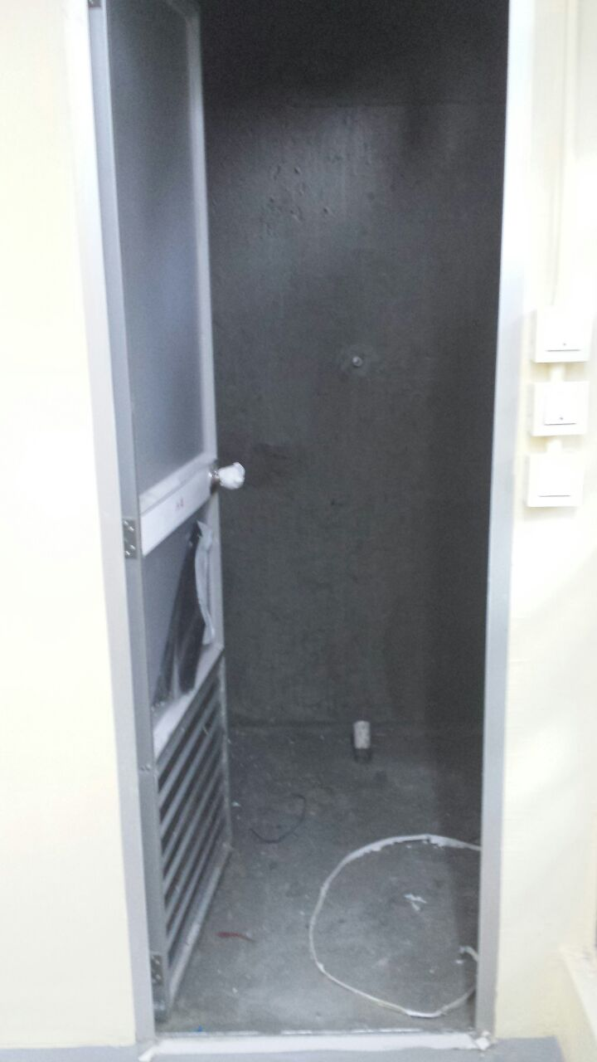
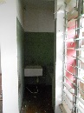
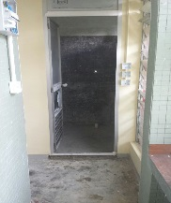
Descriptions
Site condition
VIEW 7
2014-7-6
2014-8-14

Slide 16
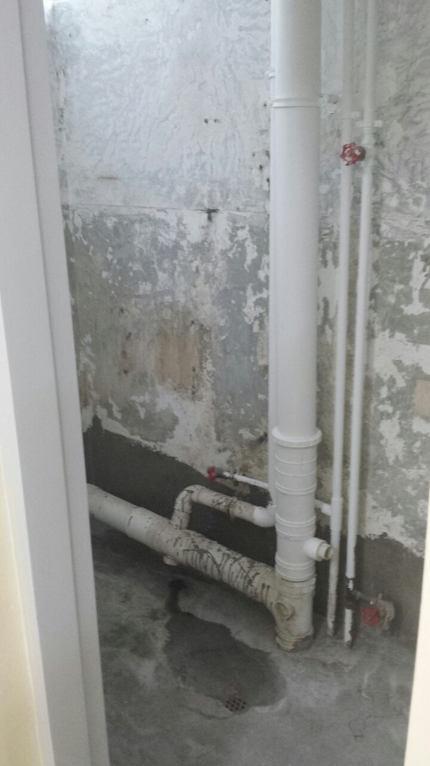
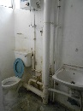
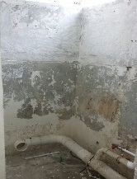
Descriptions
All the existing finish will be demolish
VIEW 8
2014-7-6
2014-8-14

Slide 17
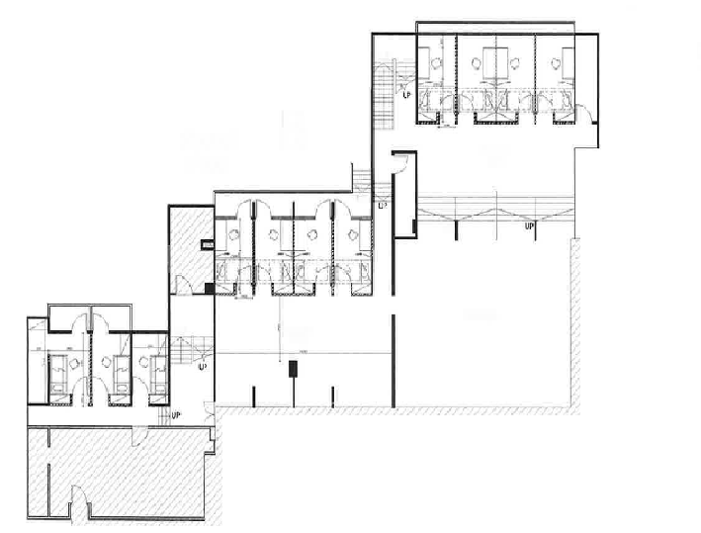
Project:
Renovation Works at Ricci Hall at 93 Pok Fu Lam Road
A
Ground Floor
VIEW 7
VIEW 5
VIEW 3
VIEW 9
B
Ground Floor
VIEW 10
VIEW 4
VIEW 8
VIEW 6
VIEW 7
VIEW 5
VIEW 3
VIEW 1
VIEW 1
VIEW 2
VIEW 2
VIEW 8
VIEW 6
VIEW 4
VIEW 14
VIEW 7
VIEW 6
VIEW 3
VIEW 1
VIEW 9
C
First Floor
VIEW 10
VIEW 13
VIEW 8
VIEW 2
VIEW 11
VIEW 12
VIEW 5
VIEW 4
PROGRESS PHOTO REPORT - 03
Date : 2014-8-21

Slide 18
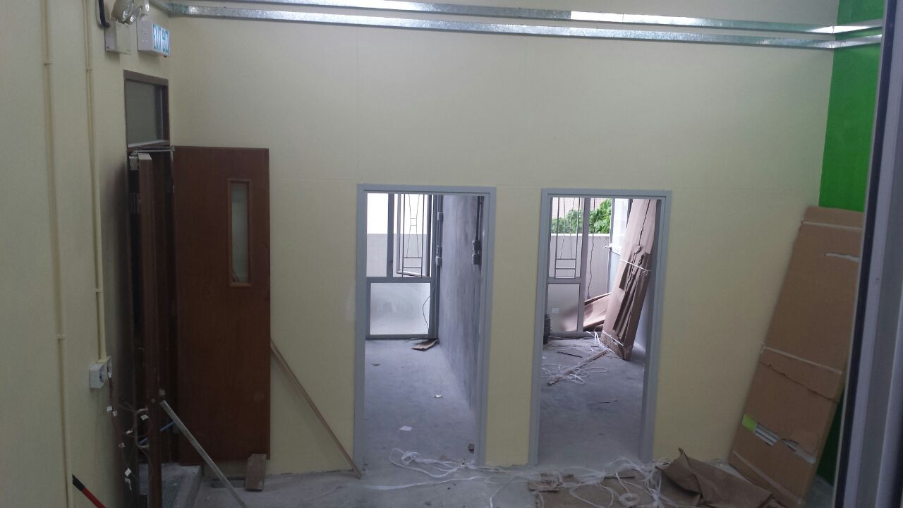
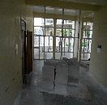
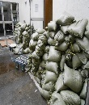
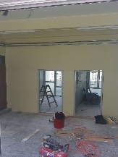
Descriptions
Paint to wall was completed
Furniture arrived on site
A
Ground Floor
VIEW 1
2014-7-6
2014-8-14

Slide 19
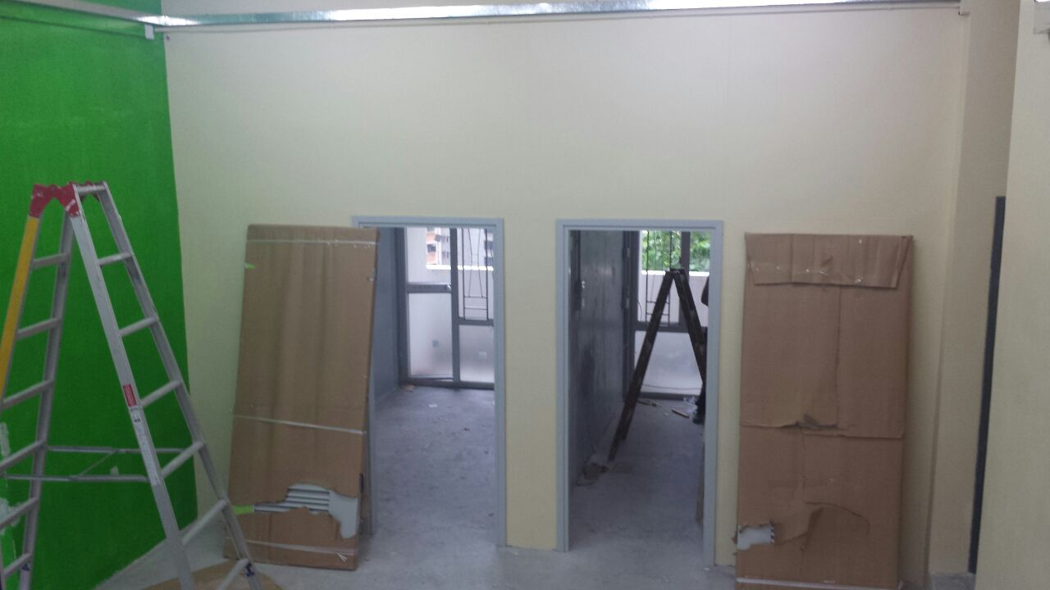
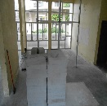
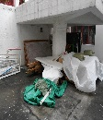

Descriptions
Paint to wall was completed
Furniture arrived on site
A
Ground Floor
VIEW 2
2014-7-6
2014-8-14

Slide 20



Descriptions
Plastering works in progress
Furniture has installed
A
Ground Floor
VIEW 3
2014-7-6
2014-8-14

Slide 21


Descriptions
Paint to wall was completed
A
Ground Floor
VIEW 4
2014-7-6
2014-8-14

Slide 22


Descriptions
Plastering works in progress
Furniture has installed
A
Ground Floor
VIEW 5
2014-7-6
2014-8-14

Slide 23


Descriptions
Site condition
A
Ground Floor
VIEW 6
2014-7-6
2014-8-14

Slide 24


Descriptions
Plastering works in progress
Furniture has installed
A
Ground Floor
VIEW 7
2014-7-6
2014-8-14

Slide 25


Descriptions
Plastering works in progress
Furniture arrived on site
A
Ground Floor
VIEW 8
2014-7-6
2014-8-14

Slide 26


Descriptions
Plastering works in progress
Furniture has installed
A
Ground Floor
VIEW 9
2014-7-6
2014-8-14

Slide 27



Descriptions
Site condition
A
Ground Floor
VIEW 10
2014-7-6
2014-8-14

Slide 28



Descriptions
Plastering works in progress
Furniture has installed
B
Ground Floor
VIEW 1
2014-7-6
2014-8-14

Slide 29


Descriptions
Site condition
B
Ground Floor
VIEW 2
2014-7-6
2014-8-14

Slide 30


Descriptions
Plastering works in progress
Furniture has installed
B
Ground Floor
VIEW 3
2014-7-6
2014-8-14

Slide 31


Descriptions
Paint to wall was completed
B
Ground Floor
VIEW 4
2014-7-6
2014-8-14

Slide 32


Descriptions
Plastering works in progress
Furniture has installed
B
Ground Floor
VIEW 5
2014-7-6
2014-8-14

Slide 33


Descriptions
Site condition
B
Ground Floor
VIEW 6
2014-7-6
2014-8-14

Slide 34



Descriptions
Plastering works in progress
Furniture has installed
B
Ground Floor
VIEW 7
2014-7-6
2014-8-14

Slide 35


Descriptions
Furniture arrived on site
B
Ground Floor
VIEW 8
2014-7-6
2014-8-14

Slide 36



Descriptions
Paint to wall was completed
The door frame has installed
B
Ground Floor
VIEW 9
2014-7-6
2014-8-14

Slide 37



Descriptions
Paint to wall was completed
The door frame has installed
B
Ground Floor
VIEW 10
2014-7-6
2014-8-14

Slide 38



Descriptions
All the existing finish will be demolish
B
Ground Floor
VIEW 11
2014-7-6
2014-8-14

Slide 39



Descriptions
All the existing finish will be demolish
Site material arrived on site
B
Ground Floor
VIEW 12
2014-7-6
2014-8-14

Slide 40



Descriptions
Paint to wall was completed
B
Ground Floor
VIEW 13
2014-7-6
2014-8-14

Slide 41



Descriptions
Paint to wall was completed
B
Ground Floor
VIEW 14
2014-7-6
2014-8-14

Slide 42


Descriptions
Plastering works in progress
C
Ground Floor
VIEW 1
2014-7-6
2014-8-14

Slide 43


Descriptions
Furniture arrived on site
C
Ground Floor
VIEW 2
2014-7-6
2014-8-14

Slide 44


Descriptions
Plastering works in progress
Furniture arrived on site
C
Ground Floor
VIEW 3
2014-7-6
2014-8-14

Slide 45


Descriptions
Furniture arrived on site
C
Ground Floor
VIEW 4
2014-7-6
2014-8-14

Slide 46


Descriptions
Furniture arrived on site
C
Ground Floor
VIEW 5
2014-7-6
2014-8-14

Slide 47


Descriptions
Plastering works in progress
C
Ground Floor
VIEW 6
2014-7-6
2014-8--14

Slide 48


Descriptions
Paint to wall was completed
C
Ground Floor
VIEW 7
2014-7-6
2014-8-14

Slide 49


Descriptions
Paint to wall was completed
C
Ground Floor
VIEW 8
2014-7-6
2014-8-14

Slide 50
Project:
Renovation Works at Ricci Hall at 93 Pok Fu Lam Road
B
First Floor
E
First Floor
E
First Floor
VIEW 2
VIEW 3
VIEW 1
VIEW 1
VIEW 1
VIEW 2
VIEW 2
PROGRESS PHOTO REPORT - 03
Date : 2014-8-21

Slide 51



Descriptions
Plastering works in progress
B
First Floor
VIEW 1
2014-7-6
2014-8-14

Slide 52



Descriptions
Plastering works in progress
B
First Floor
VIEW 2
2014-7-6
2014-8-14

Slide 53



Descriptions
Tile works was completed
B
First Floor
VIEW 4
2014-7-6
2014-8-14

Slide 54



Descriptions
Tile works was completed
E
First Floor
Female Toilet & Disable toilet
VIEW 1
2014-7-6
2014-8-14

Slide 55



Descriptions
Tile works was completed
E
First Floor
Female Toilet & Disable toilet
VIEW 2
2014-7-6
2014-8-14

Slide 56



Descriptions
Plastering works in progress
The door frame has installed
E
First Floor
Male Toilet
VIEW 1
2014-7-6
2014-8-14

Slide 57



Descriptions
Plastering works in progress
The door frame has installed
E
First Floor
Male Toilet
VIEW 2
2014-7-6
2014-8-14

